Slide 1
Versioning of Simulink files.
MATLAB 2021b
Create a git REPO in git account.
Select New project from Git.
Paste the repository path.
Change the sandbox folder path to work directory.
Ex: E:\Personal\matgit
Click on retrieve. (Git attributes will be automatically created in 2020b)
Once retrieved all the content of repository will be seen.
Steps to add new file.
Go to current folder window and click on new file.
Create .m/.mdl/slx files.
Add the content in the files.
Drag the file to Project window.
Press on commit and add the comments in the dialogue box and click on submit.
Then click on push and enter login credentials.
Go back to Git repo and check the update of repository.
Modifying the existing file.
After modifying again commit and push. (Every time we need to login.???)
How to view modified/revised content? Refer slides
Things needs to be explored:
Team members working on same file??
How branch/merge with root branch?
Authority to accept revisions/modifications.??

Slide 2
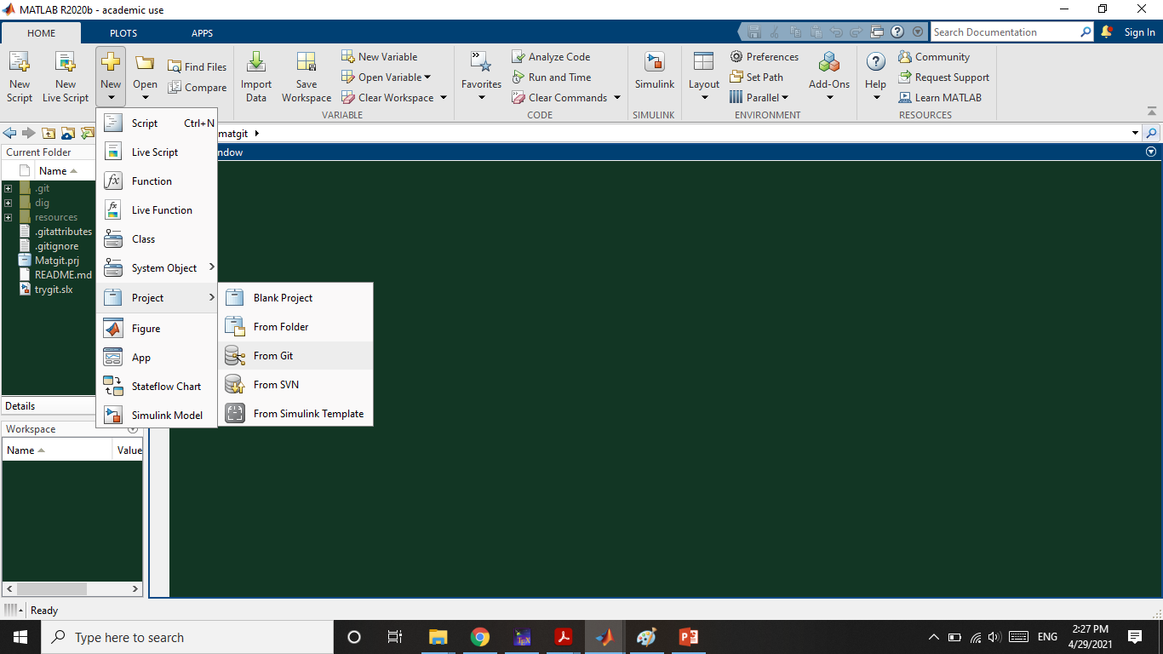

Slide 3
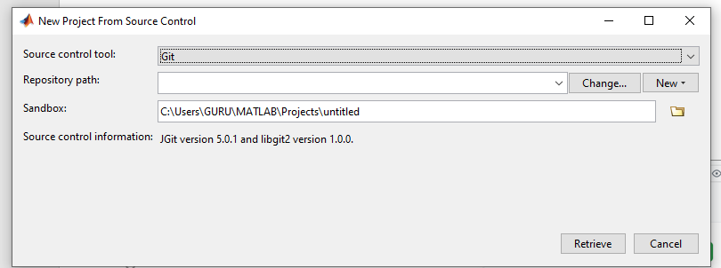
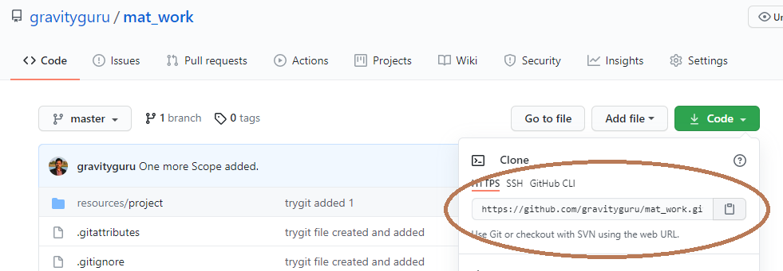

Slide 4
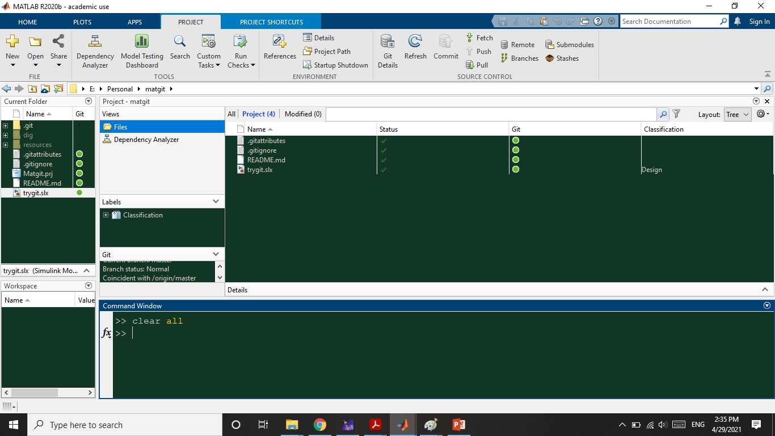

Slide 5
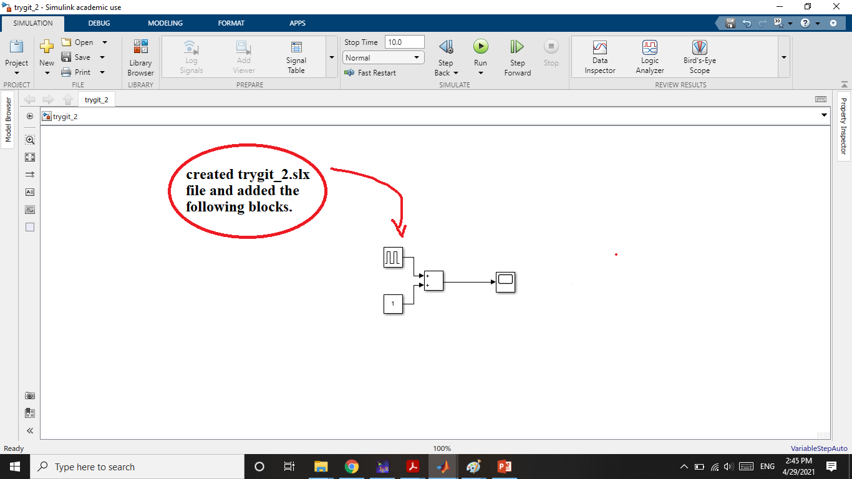

Slide 6
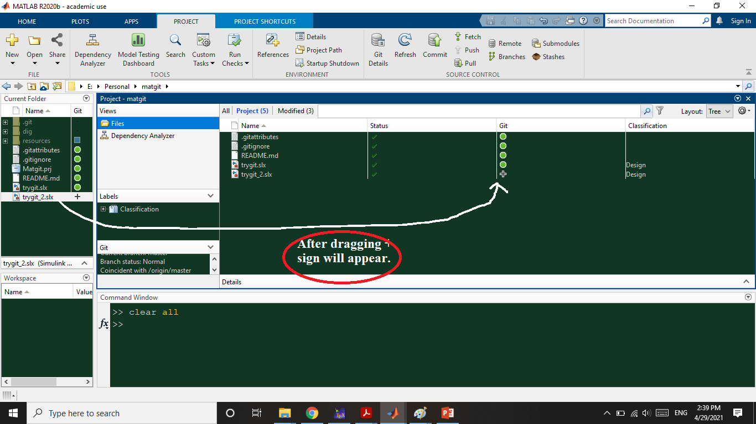

Slide 7
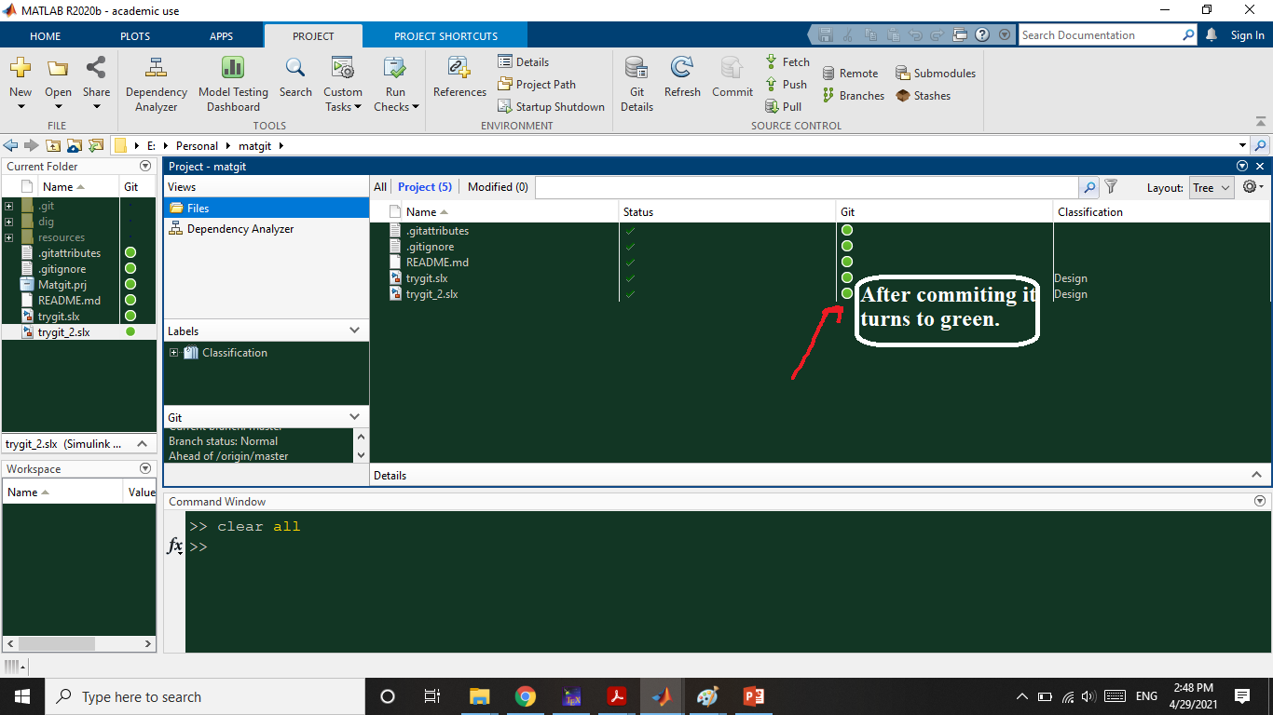

Slide 8
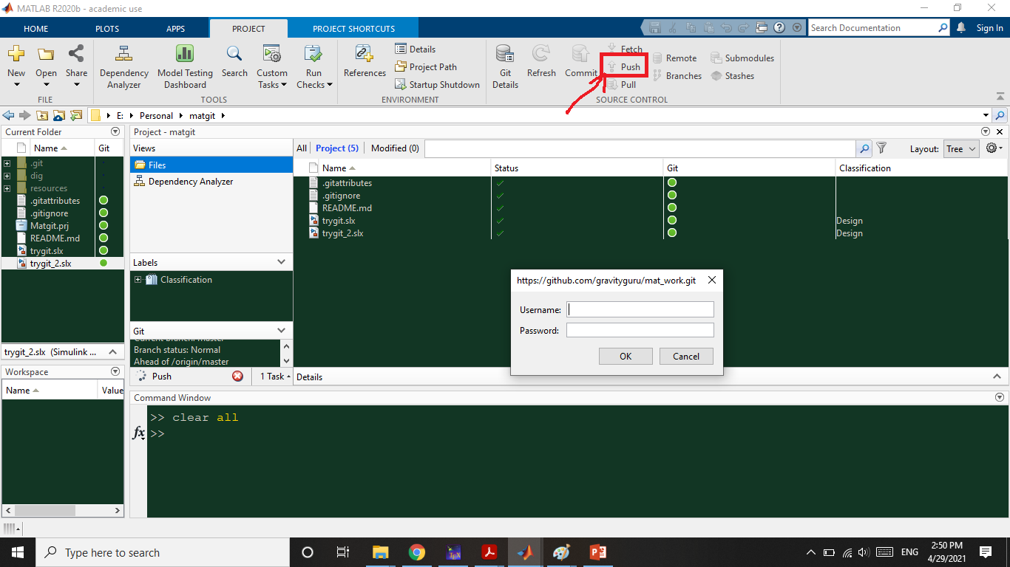

Slide 9
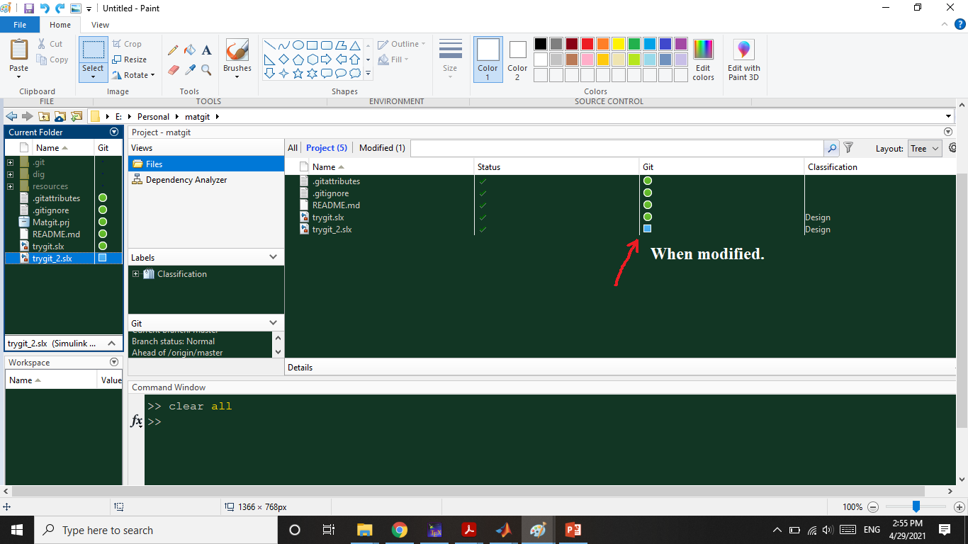

Slide 10
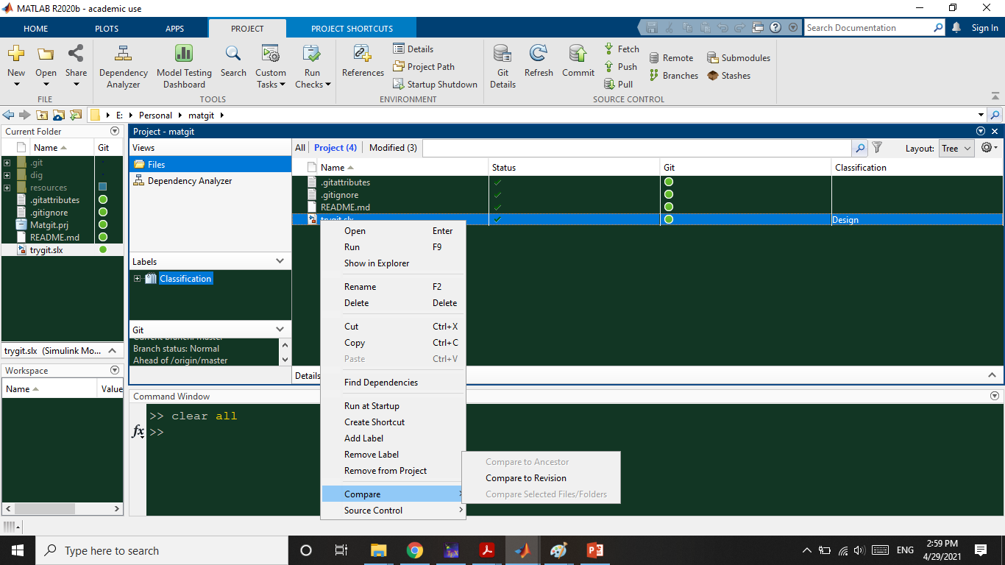

Slide 11
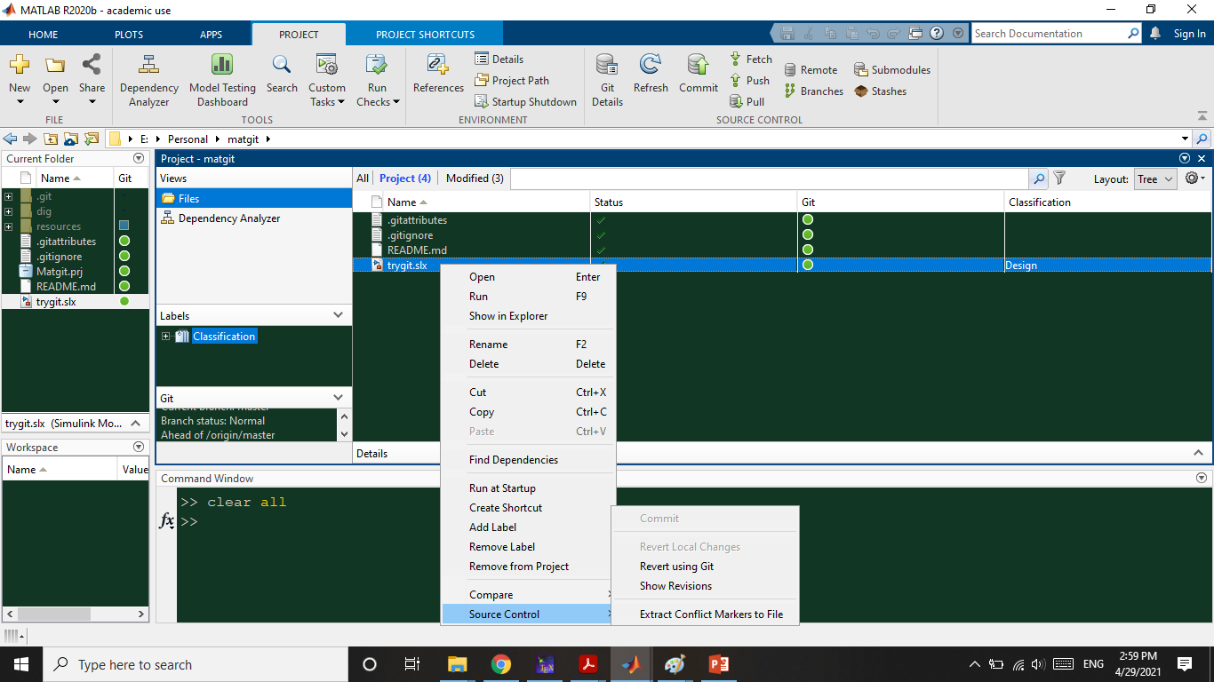

Slide 12
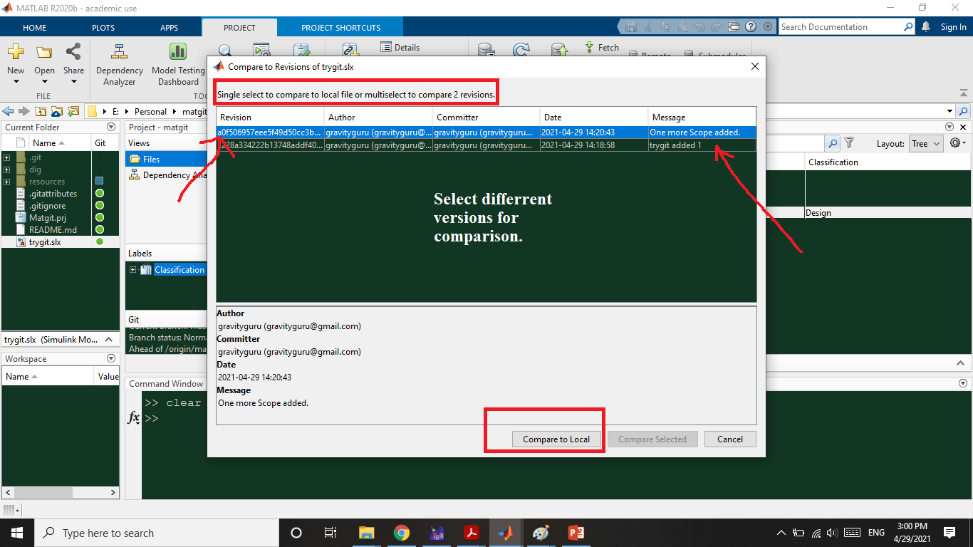

Slide 13
